Slide 1
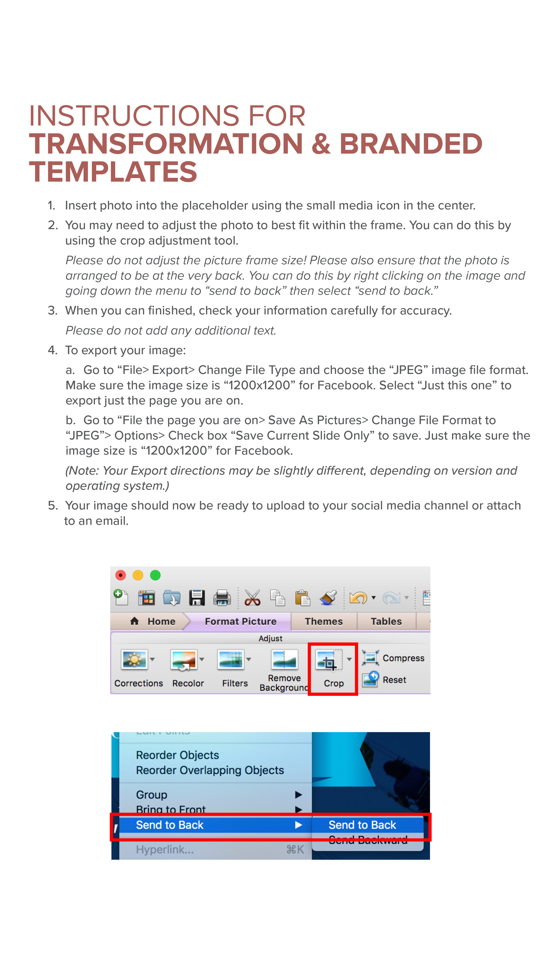

Slide 2

Event Name
Host Name
Date
Time & Location

Slide 3

Event Name
Host Name
Date
Time
Location

Slide 4

Event Name
Host Name
Date & Time
Location

Slide 5

Event Name
Host Name
Date & Time
Location

Slide 6

Event Name
Host Name
Date & Time
Location

Slide 7

Event Name
Date & Time
Location
Details

Slide 8

Event Name
Date & Time | Location
Details

Slide 9

Event Name
Date & Time | Location
Details

Slide 10

Event Name
Date & Time
Location
Details

Slide 11

Event Name
Date & Time | Location
Details

